Slide 1

Rise/Quad
Tableau Work Examples
For Analytics Manager (Business Intelligence, Media)
Kevin Tran

Slide 2
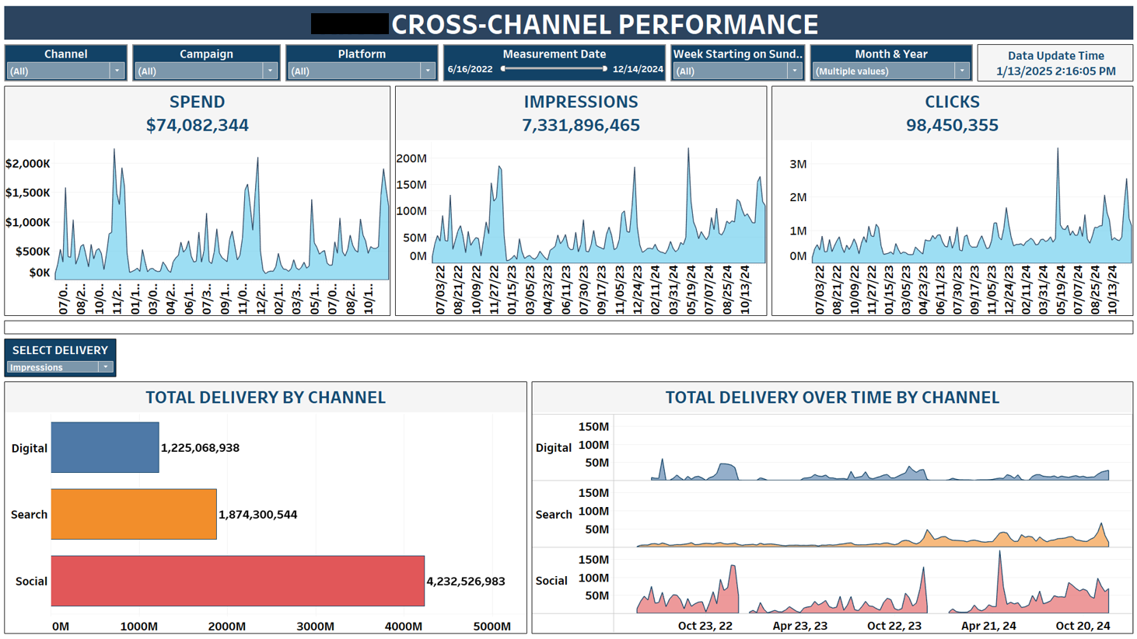
Data Visualization Example

Slide 3
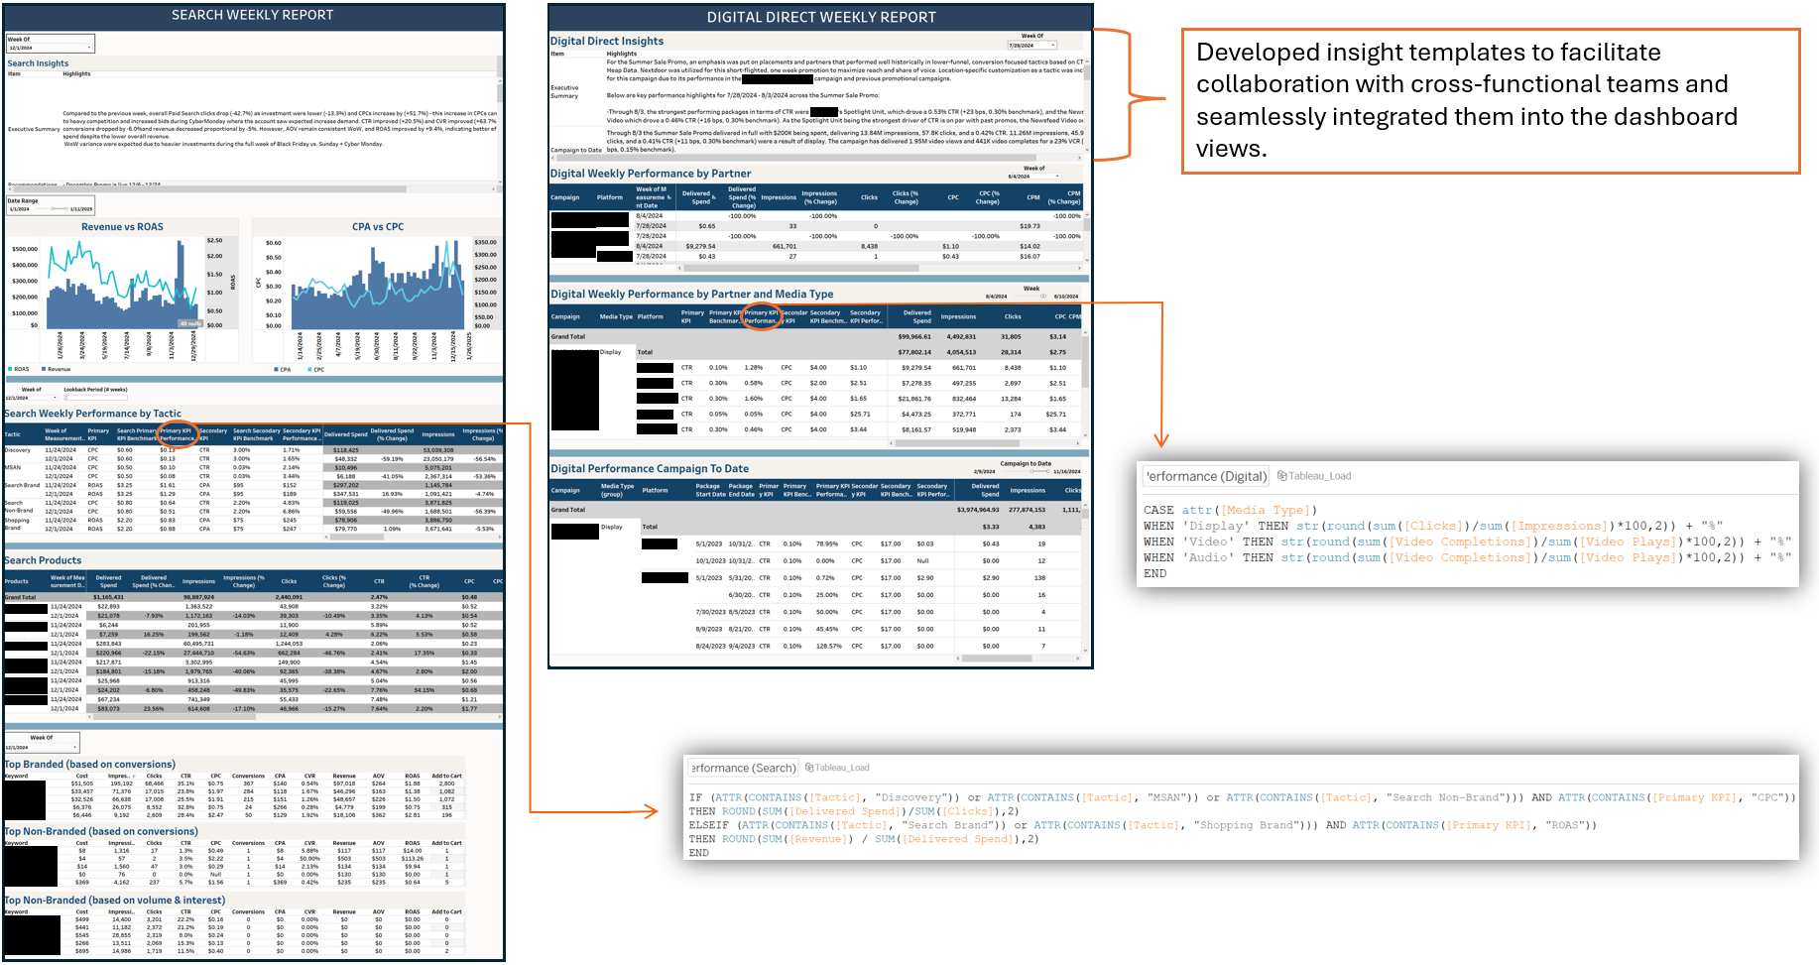
Transforming Excel Reports into Interactive Tableau Dashboards

Slide 4
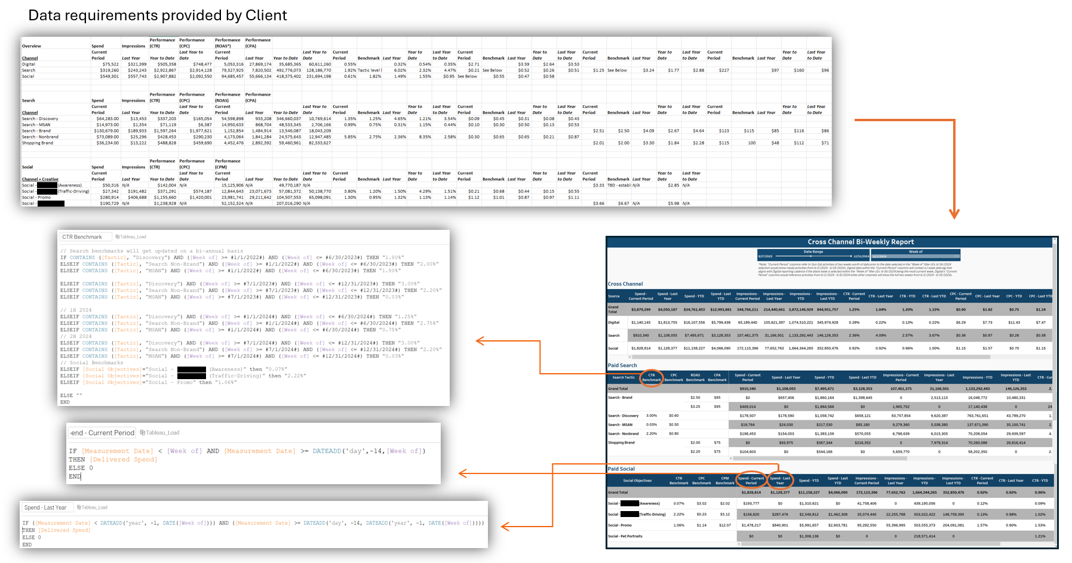
Designing a Custom Dashboard Solution for the Client

Slide 5
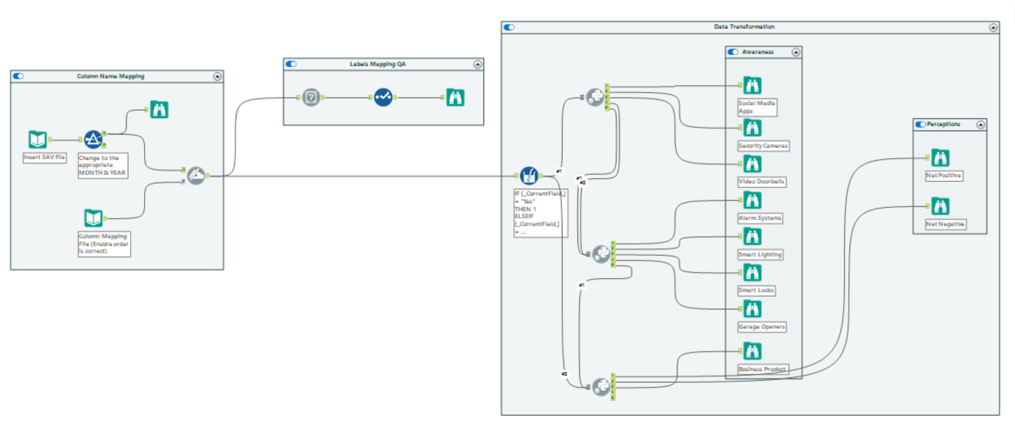
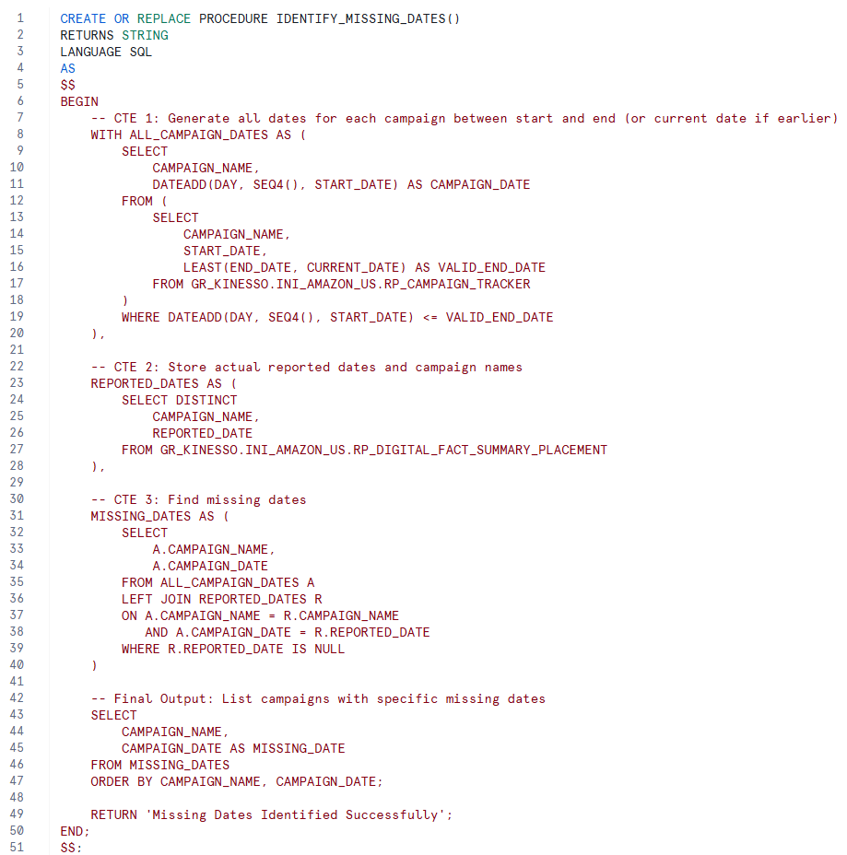
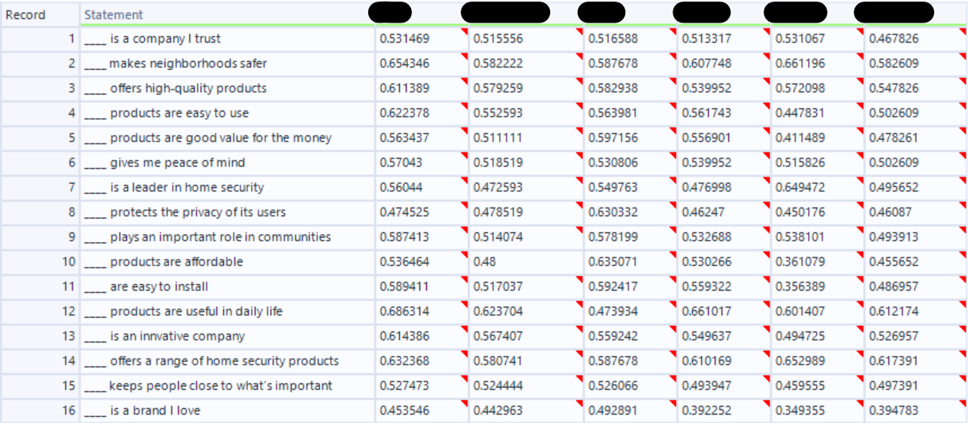
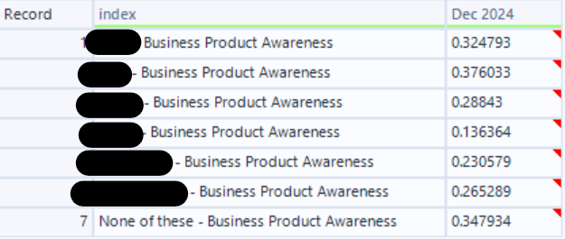
Additional Work Samples
Alteryx Workflow with Integrated Jupyter Notebooks to Streamline Data Processing
SQL Stored Procedure to QA for Missing Dates

Slide 6
THANK YOU

